Slide 1
The Contribution of Within- and Between-Subject Variations to Dietary Pesticide Exposures
Chensheng (Alex) Lu, PhD,
Mark and Catherine Winkler Associate Professor
Department of Environmental Health
Harvard School of Public Health

Slide 2
Dietary Pesticide Exposure Guideline
Unlike nutrient guideline (e.g. food pyramid, or food plate), there are no explicit policies for guiding dietary pesticide intakes,
Two landmark events occurred in the 1990’s intended to provide guidance of pesticide policy in the U.S.;
  Pesticides in the Diets of Infants and Children – National Academy of Science/National Research Council 1993,
  The Food Quality Protection Act - 1996.

Slide 3

Pesticides in the Diets of Infants and Children
Executive Summary;
Dietary intake represents the major source of pesticide exposure for infants and children, and the dietary exposure may account for the increased pesticide-related health risks in children compared to adults

Slide 4
The Food Quality Protection Act- 1996
Fundamental change of the U.S. pesticide regulation since 1947 under FIFRA,
Mandate US EPA to assure that there is a “reasonable certainty of no harm” from pesticide exposures for pregnant women, infants, children, and other vulnerable groups.

Slide 5
Objectives
Intended to illustrate;
  The magnitude of potential error introduced by using cross-sectional data to estimate dietary pesticide exposure, mainly from the food consumption frequency/patterns, among young children,
  How those errors be impacted on characterizing the variance components that will subsequently affect statistical inferences for study hypotheses.

Slide 6
National Health and Nutrition Examination Survey (NHANES)
Publically available data for every two years,
Cross-sectional study design,
Dietary consumption data collected in a 24-hr recall interview, with a follow-up interview via telephone 3-10 days later,
The public release data do not contain information on date/season or geographic location of data collected,
http://www.cdc.gov/nchs/about/major/nhanes

Slide 7
Children Pesticide Exposure Study (CPES)
Designed to assess dietary exposures to OPs and pyrethroids in children ages 3-11 over a 12-month period,
Children lived in Seattle, WA, or Atlanta GA,
Multiple consecutive daily dietary consumption information collected in four seasons,
In two of the four seasons, children consumed organic fruits, vegetables, and juices over 5 consecutive days.

Slide 8
NHANES – CPES Dietary Consumption Comparison
Matched children with ages and annual household incomes (> $75,000) for NHANES 2003-2004 (8.78 million US children),
Selected food items for comparison based on;
  Frequency of consumption,
  Frequency of detection of pesticide residues,
  Matched 8-digit USDA Food and Nutrient Database for Dietary Studies (FNDDS).

Slide 9
Percent (%) Eaters
Defined as “percentage of respondents (children) who reported eating a certain food item in a 24-hr period,
  A 24% eaters of strawberries means 24% of study participants ate strawberries during that day.

Slide 10
Statistical Analysis
SAS SUDAAN SUBPON to subset the NHANES data for ages and incomes matching with CPES,
SAS SUDAAN CROSSTAB to calculate weighted consumption frequencies and 95% CL for the selected food items,
SAS to calculate %Eaters CPES-WA and CPES-GA.

Slide 11
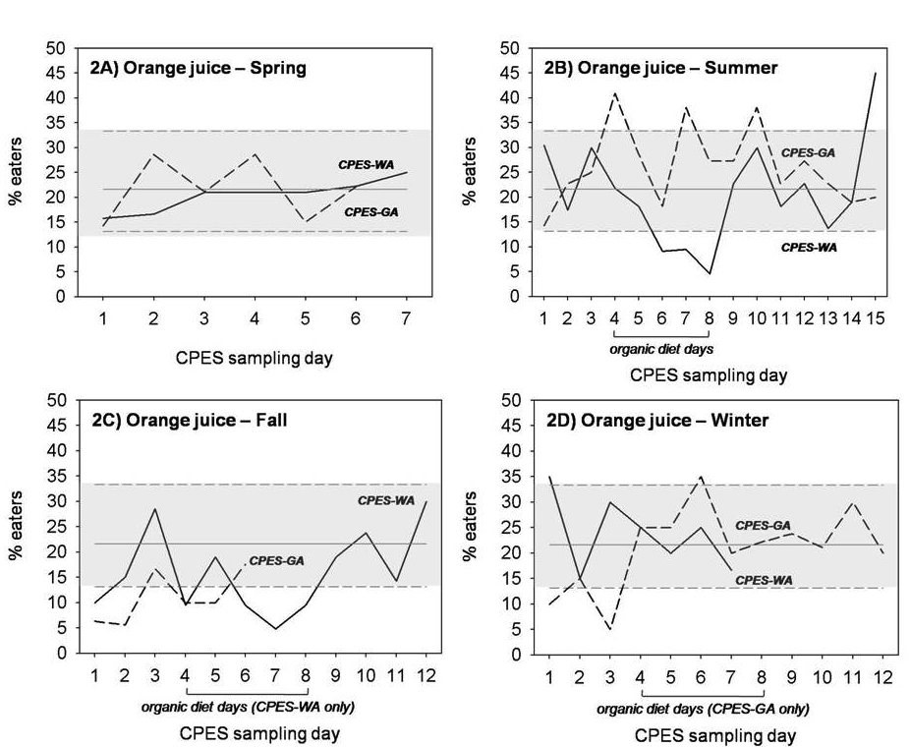
Frequency of orange juice consumption in CPES vs. NHANES children

Slide 12
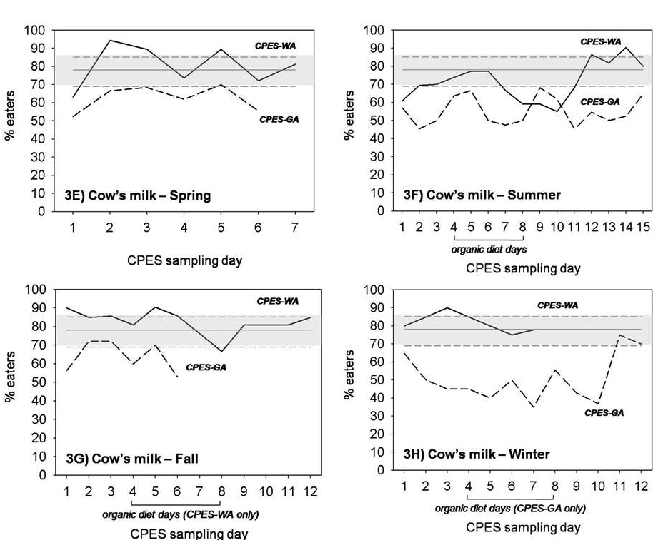
Frequency of cow milk consumption in CPES vs. NHANES children

Slide 13
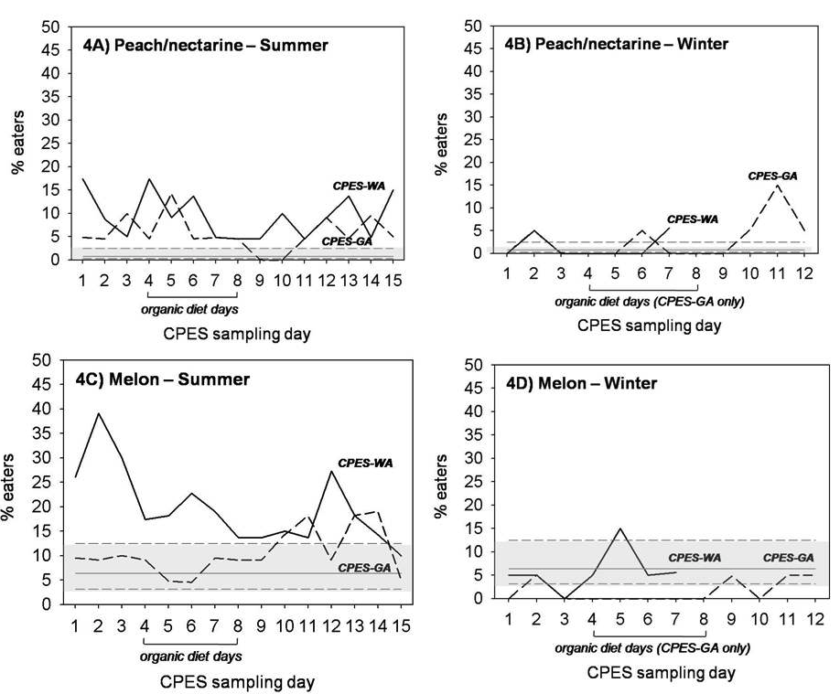
Frequency of peach/nectarine and melon consumption in CPES vs. NHANES children

Slide 14
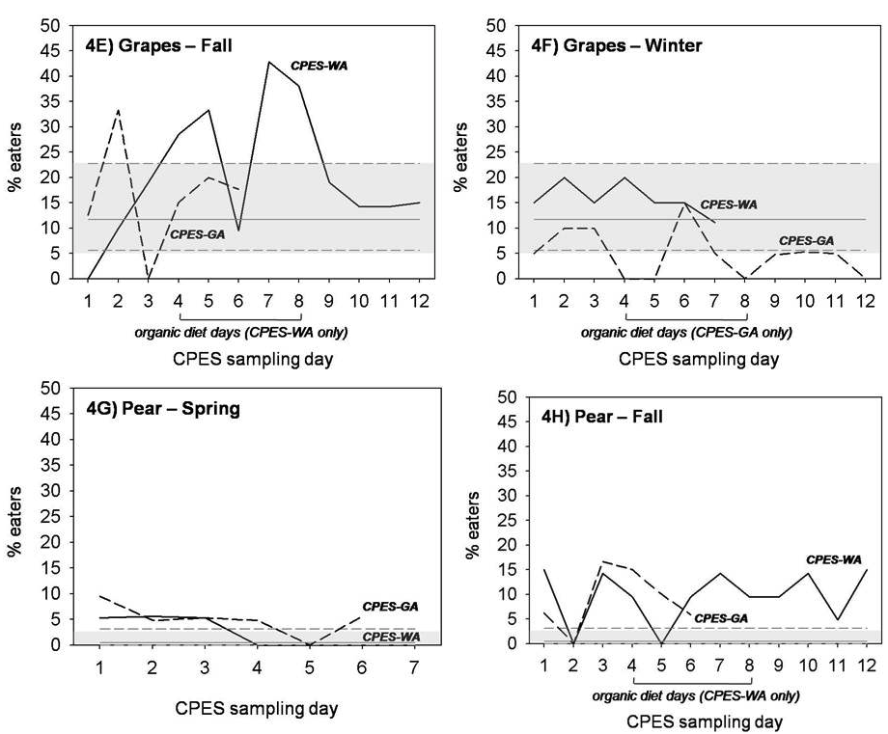
Frequency of grapes and pear consumption in CPES vs. NHANES children

Slide 15
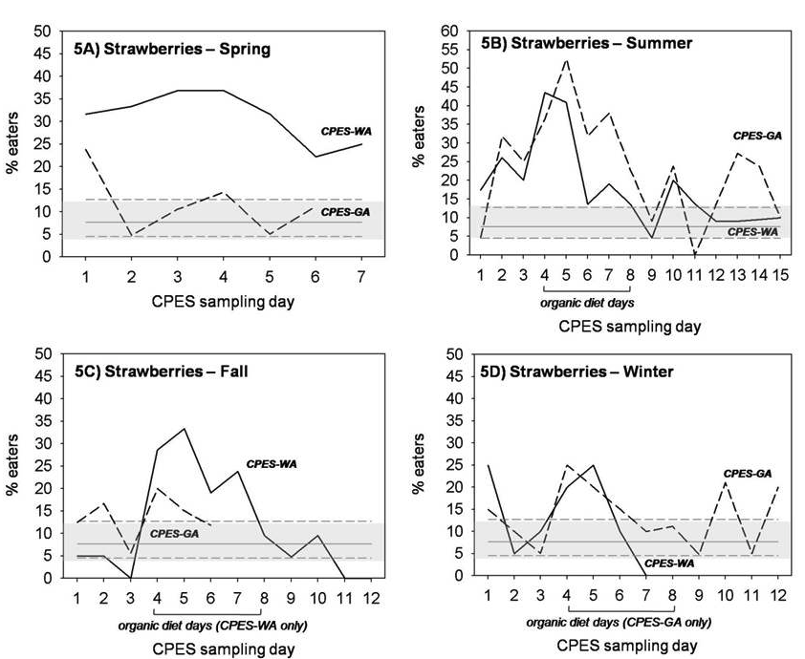
Frequency of strawberries consumption in CPES vs. NHANES children

Slide 16
Bootstrapping Statistical Analysis
Following the central limit theorem, repeated sampling of data from CPES, across days and seasons, would produce a distribution of food consumption frequencies that resemble the NHANES estimates, if enough samples are taken from the CPES dataset.
SAS PROC SURVEYFREQ to perform randomly re-sampling of;
  CPES one-day food consumption data for 5,000 times, resulting to 5,000 days of %Eaters estimates,
  The bootstrapped distribution of %Eaters with the NHANES estimates.

Slide 17
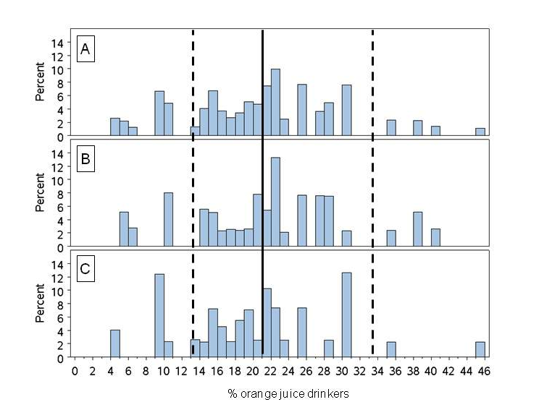
Histograms of randomly re-sampled of percent orange juice drinkers among CPESª children comparing to NHANES^{b} children
ª Histograms A: combined CPES data, B: CPES-GA, C: CPES-WA.
^{b} Solid line indicated weighted %Eaters and dash lines indicated 95%CL of NHANES data.

Slide 18
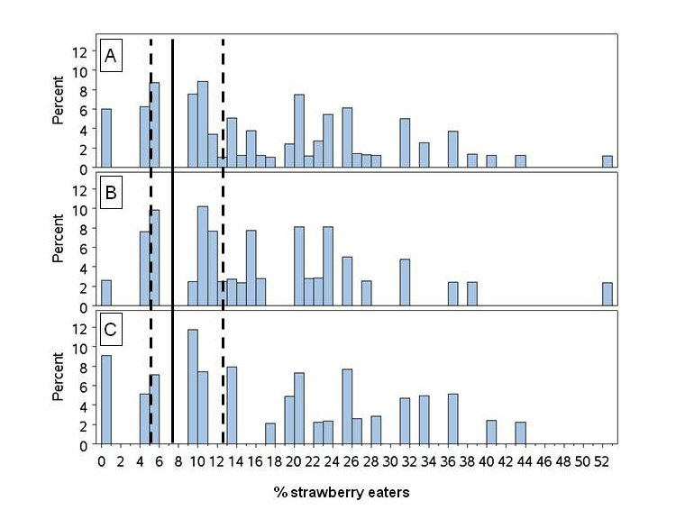
Histograms of randomly re-sampled of percent strawberry eaters among CPESª children comparing to NHANES^{b} children
ª Histograms A: combined CPES data, B: CPES-GA, C: CPES-WA.
^{b} Solid line indicated weighted %Eaters and dash lines indicated 95%CL of NHANES data.

Slide 19
Conclusions
Significant errors would be introduced, if NHANES food consumption data are extracted for use in occasions in which seasonality, geographical locations, and/or the socioeconomic background of the study participants are important study variables.

Slide 20
Conclusions
The difference of dietary consumption patterns between cross-sectional and longitudinal surveys;
  likely to be attributable by either seasonal availabilities of certain foods, geographical differences, or both,
  would be significant for estimating dietary pesticide intakes due to the fact that pesticide residues are often detected in seasonal produces, such as apples, peaches, strawberries, etc.,
  would substantially impact on the partitioning of within- and between-subject variations in the overall variance component.

Slide 21
The Within- and Between-Subject Variations
Between-subject (inter-individual) variation is often considered the most significant component of the overall variance in epidemiologic research,
Within-subject (intra-individual) variation is often assumed to be insignificant to the overall variance,
Those are facts only if the underlying causes (exposure) of the outcome of interest is static, or can be dichotomized, in nature.

Slide 22
The Characterizations of Within- and Between-Subject Variations for Several Pesticide Urinary Metabolites Measured in CEPS Children

Slide 23
The Implications of Within- and Between-Subject Variations to Environmental Epidemiological Research
Sample size calculation;
  How many participants to sample from vs. How often to sample individual participants
Statistical reference;
  The magnitude of the uncertainty of characterizing the overall variance component can be enormous (3-5 orders differences)
Presumption of the dominance of between-subject variation might often be incorrect, particularly in dealing with “scenarios” in which individuals’ activities (eating foods) define the variation.

Slide 24
Limitations of the Analyses
The observed difference of dietary consumption patterns might result from the methodological differences of survey methods used in NHANES vs. CPES;
  Weighted mean # of foods recorded per NHANES recall interview was 13.4 (12.8 – 14.1 CL),
  12.5 – 15.8 (11 – 15.3) for CPES-WA (for CPES-GA).
The restriction of CPES children in a particular socioeconomic subgroup;
  Household incomes and race/ethnicity are significant predictors of %Eaters for more than half of the food items that are included in the analysis.

Slide 25
References
Riederer AM, Pearson M.A., Lu C. (2009). J Exp Sci Environ Epidemiol. Epub ahead of print (Sept. 9th, 2009). PMID: 19738638.
Riederer AM, Pearson MA, Lu C. (2010). J Exp Sci Environ Epidemiol. Epub ahead of print (March 31st, 2010), PMID: 20354565.
Lu C, Toepel K, Irish R, Fenske RA, Barr DB, Bravo R. (2006). Environ Health Perspect, 114(2): 260-263. PMID: 16451864.
Lu C, Barr DB, Pearson MA, Waller LA (2008). Environ. Health Perspect. 116(4)537:542. PMID: 18414640.
Given M, Lu C, Bartell S, Pearson MA (2007). Environ. Res. 103:325-330. PMID: 16908016.

