Slide 1
Comparison of Calcium and Vitamin D Content in a Market Basket Survey of Plant-based
Milk Alternatives
Benjamin Redan, PhD
Research Chemist
CFSAN/Office of Food Safety
JIFSAN-CFS3 Advisory Council’s Webinar Series
September 22, 2022

Slide 2

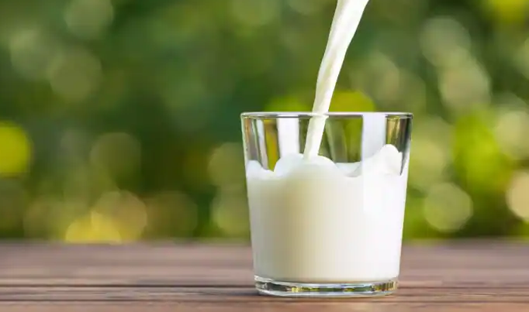
Background
Although fluid milk consumption has been declining in the US, there has been an increase in consumers including plant-based milk alternatives (PBMAs) in their diets [1]
The Dietary Guidelines for Americans has identified the dairy group as being a key source of calcium and vitamin D in the American diet [2]
Calcium and vitamin D are essential micronutrients with roles in maintaining immune function, bone health, and a number of other biological functions [2,3]
1. Stewart et al. (2020) Are plant-based analogues replacing cow’s milk in the American diet? J. Agric. Appl. Econ., 52, 562-579.
2. USDA and HHS. (2015). Dietary Guidelines for Americans 2015-2020. (8th ed.). Washington, DC: GPO.
3. Institute of Medicine, Food and Nutrition Board. Dietary Reference Intakes.
2

Slide 3
Background, cont’d
For those >18 years old, the recommended daily allowances (RDA) are 1,000-1,200 mg/day for calcium and 15-20 µg/day for vitamin D [1]
Data on the calcium and vitamin D amounts in PBMAs are necessary when comparing the nutritional content in milk to PBMAs
However, there is limited publicly available information on the amounts and variability of these micronutrients in PBMAs
20
Ca
Calcium
Vitamin D3
(cholecalciferol)
1. Institute of Medicine, Food and Nutrition Board. Dietary Reference Intakes for Calcium and Vitamin D. Washington, DC: National Academy Press, 2010.
3

Slide 4
Overview of the PBMA Market in the US
Total plant-based beverage market of at least $2.36 billion
Almond-based beverages constitute the largest PBMA market category
Data spans conventional multioutlet channels for 52 weeks to Sept 2020.
FoodNavigator-USA. “Oatmilk edges past soymilk for #2 slot in US plant-based milk retail market”
4
Notes:
https://www.foodnavigator-usa.com/Article/2022/07/25/Plant-based-milk-by-numbers-US-retail-Oat-milk-and-pea-milk-up-double-digits-almond-milk-and-soy-milk-flat#:~:text=Almond%20milk%2C%20meanwhile%2C%20experienced%20a,oat%20milk%20at%20%24527.44m.

Slide 5
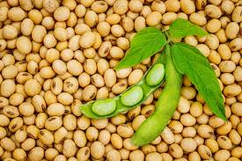
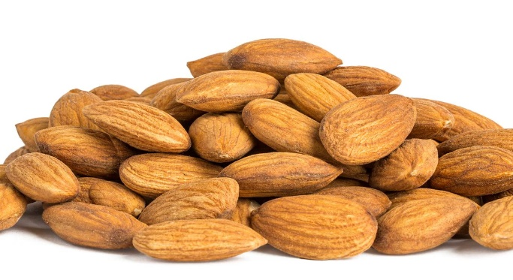
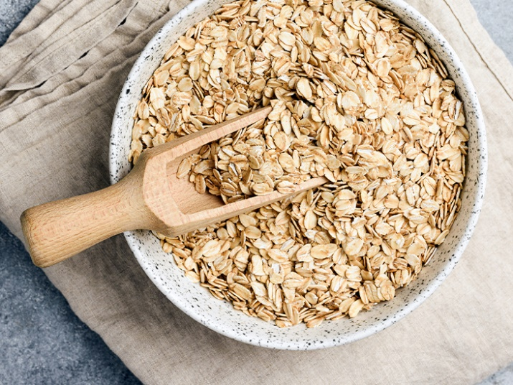
Overview of PBMA Product Sampling
Almond
Cashew
Coconut
Hemp
Oat
Pea
Rice
Soy
Samples from 10 retail markets in the greater Chicago area plus an online retailer
Brands (n=2-3)
Across Three Lots
for Almond
Within a Lot (n=3-5)
Total of 85-90 unique
sample units
5

Slide 6

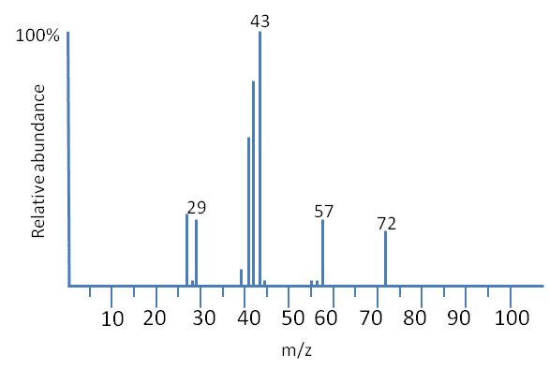
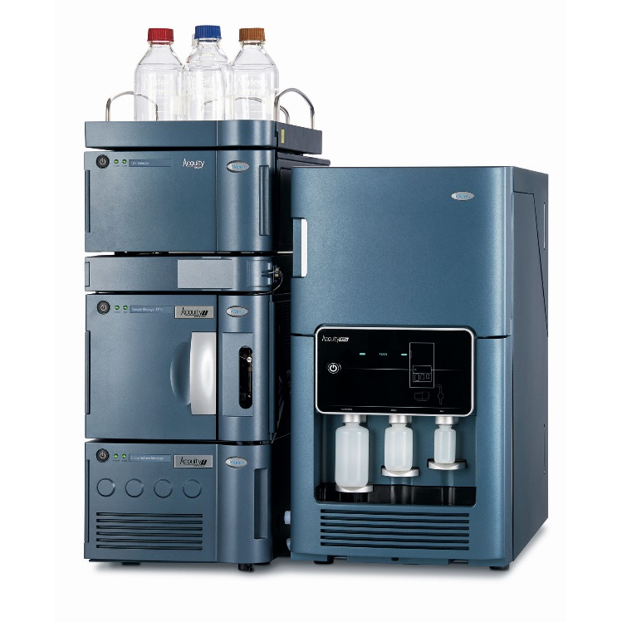
Vitamin and Mineral Analysis Methodology
Calcium Analysis
Analysis using ICP-MS
Microwave digestion
with nitric acid
Beverage
Sample
Vitamin D Analysis
Analysis using LC-MS/MS
4
Filter sample
x10
4
2
Add internal standard (d₆-vitamin D2 and D3)
Liquid/liquid extraction
0
Time (min)
5
6

Slide 7
Calcium Analysis
7

Slide 8
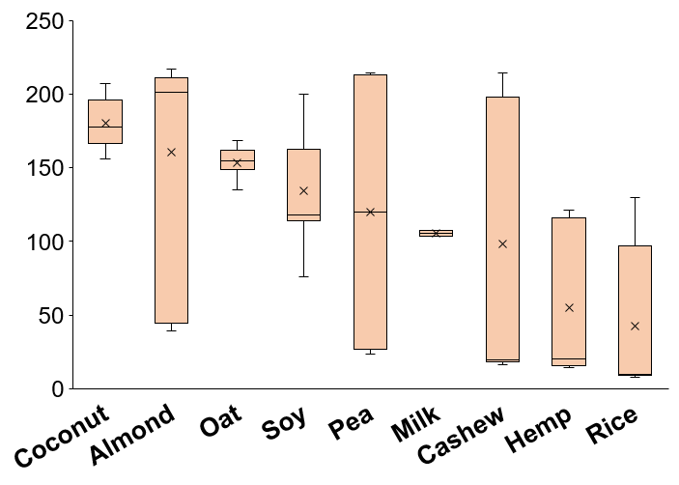
Measured Calcium in a Market Basket of PBMAs
a
b
85 unique samples were analyzed using ICP-MS
Sample data are grouped by PBMA type
Nutrition Facts label declared that calcium was added to all PBMAs except for one rice brand
Average calcium amounts in milk were not significantly (P<0.05) different compared to any PBMA type
c
Calcium
(mg/100 g portion)
Milk
8
Values not sharing the same letter are significantly different (P<0.05) as determined by Tukey’s honest significant difference (HSD) post hoc test.

Slide 9
Calcium Variability Across Different Brands of PBMAs
Almond
Cashew
Coconut
Hemp
PBMAs formulated with added calcium appeared to be the major driver of calcium levels
Only one brand did not contain added calcium (rice PBMA R2), which was ~90% lower than levels in milk.
Only oat PBMAs did not contain different amounts of calcium across brands
Values not sharing the same letter within PBMA type contain significantly different (P<0.05) calcium amounts as determined by Tukey’s HSD post hoc test
a
a
b
a
b
Calcium
(mg/100 g portion)
a
b
a
b
A1
A2
A3
CW1
CW2
CT1
CT2
H1
H2
Oat
Pea
Rice
Soy
a
NS
b
a
a
a
Calcium
(mg/100 g portion)
b
b
O1
O2
O3
P1
P2
R1
R2
S1
S2
S3
Brand Code
9

Slide 10
Calcium Variability Across Different Lots of Almond PBMA
Almond PBMA
a
There was a small but significant (P<0.05) difference in calcium amounts across three lots of brand A almond beverage (n=10)
Values not sharing the same letter are significantly different (P<0.05) as determined by Tukey’s HSD post hoc test
b
a,b
Calcium
(mg/100 g portion)
1
2
3
Lot
10

Slide 11
Type/brand code | % Difference from Declared Value for Calcium | Calcium Ingredient(s) on Nutrition Facts Label
Milk | -9.4 | -
Almond
Almond/A1 | +9.0 | calcium carbonate
Almond/A2 | +11.2 | calcium carbonate
Almond/A3 | -20.2 | calcium carbonate
Oat
Oat/O1 | +8.2 | calcium carbonate
Oat/O2 | +14.6 | calcium carbonate; tricalcium phosphate
Oat/O3 | +4.8 | calcium carbonate; tricalcium phosphate
Soy
Soy/S1 | -11.2 | calcium carbonate
Soy/S2 | -0.8 | calcium carbonate
Soy/S3 | +1.6 | calcium carbonate; tricalcium phosphate
Calcium
% difference of the average measured amount of calcium vs. declared value on the Nutrition Facts label
All 9 brands were within ~20% of the declared value
6/9 brands were above the declared value
11

Slide 12
Vitamin D Analysis
12

Slide 13
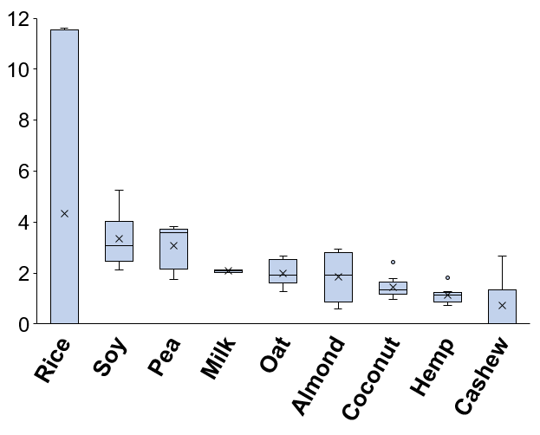
Measured Vitamin D in a Market Basket of PBMAs
a
Samples (n=90) were analyzed for vitamins D2 and D3 using LC-MS
Sample data are grouped by PBMA type
PBMAs with vitamin D added by the manufacturer contained the D2 form except for one brand of oat and pea PBMA (O2 and P2), which contained D3
Average vitamin D amounts in milk were not significantly (P<0.05) different compared to any PBMA type
Vitamin D
(µg/100 g portion)
a
b
Milk
Values not sharing the same letter are significantly different (P<0.05) as determined by Tukey’s HSD post hoc test.
1µg vitamin D=40 IU.
13

Slide 14
Vitamin D Variability Across Different Brands of PBMAs
Almond
Cashew
Coconut
Hemp
There was no detectable vitamin D unless added to the product by the manufacturer
Three PBMA types (coconut, hemp, soy) did not have significantly (P<0.05) different vitamin D amounts across brands
Vitamin D in brand P1 could not be determined due to poor analyte recovery
Values not sharing the same letter within PBMA type are significantly (P<0.05) different as determined by Tukey’s HSD post hoc test
a
a
NS
Vitamin D
(µg/100 g portion)
NS
b
<LOQ
Oat
Pea
Rice
Soy
NS
c
a
b
Vitamin D
(µg/100 g portion)
<LOQ
Brand Code
14

Slide 15
Vitamin D Variability Across Different Lots of Almond PBMA
Almond PBMA
a
a
Significant (P<0.05) difference in vitamin D amounts across three lots of brand A almond PBMA (n=10)
Values not sharing the same letter are significantly different (P<0.05) as determined by Tukey’s HSD post hoc test
Vitamin D
(µg/100 g portion)
b
15

Slide 16
Type/brand code | % Difference From Declared Nutrition Facts Label Value for Vitamin D
Milk | -1.0
Almond
Almond/A1 | +6.2
Almond/A2 | +154.0
Almond/A3 | -63.3
Oat
Oat/O1 | +11.2
Oat/O2 | +22.3
Oat/O3 | +73.3
Soy
Soy/S1 | +56.0
Soy/S2 | +36.0
Soy/S3 | +80.8
Vitamin D
% Difference of the average measured amount of vitamin D vs. declared value for the top three most popular PBMAs
Only 2 brands were within 20% of declared value on Nutrition Facts panel
8/9 brands were above the declared value
16

Slide 17
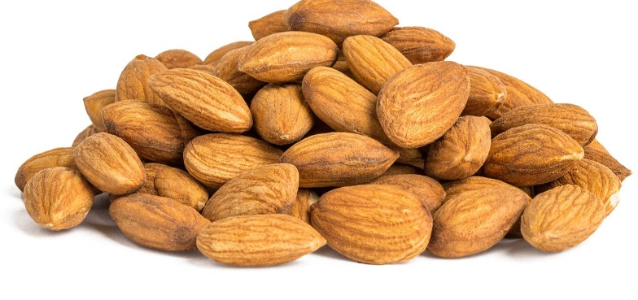
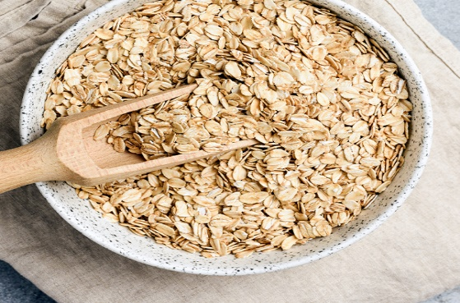
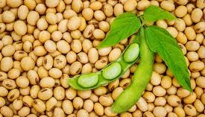
Conclusions
There were differences in the amounts of vitamin D and calcium declared on the Nutrition Facts label and the measured content in some PBMA brands
All brands in the three most popular PBMA types (almond, soy, oat) contained calcium levels within 20% the of declared value. Added calcium appeared to be the major driver of calcium levels in PBMAs
In the majority of PBMA brands formulated with added vitamin D, the measured amount differed by >20% compared to the declared amounts
Only two brands in the top three most popular PBMA types (almond, soy, oat) contained vitamin D within 20% of the declared value. Measured vitamin D levels in PBMAs tended to be higher than the declared value
17

Slide 18
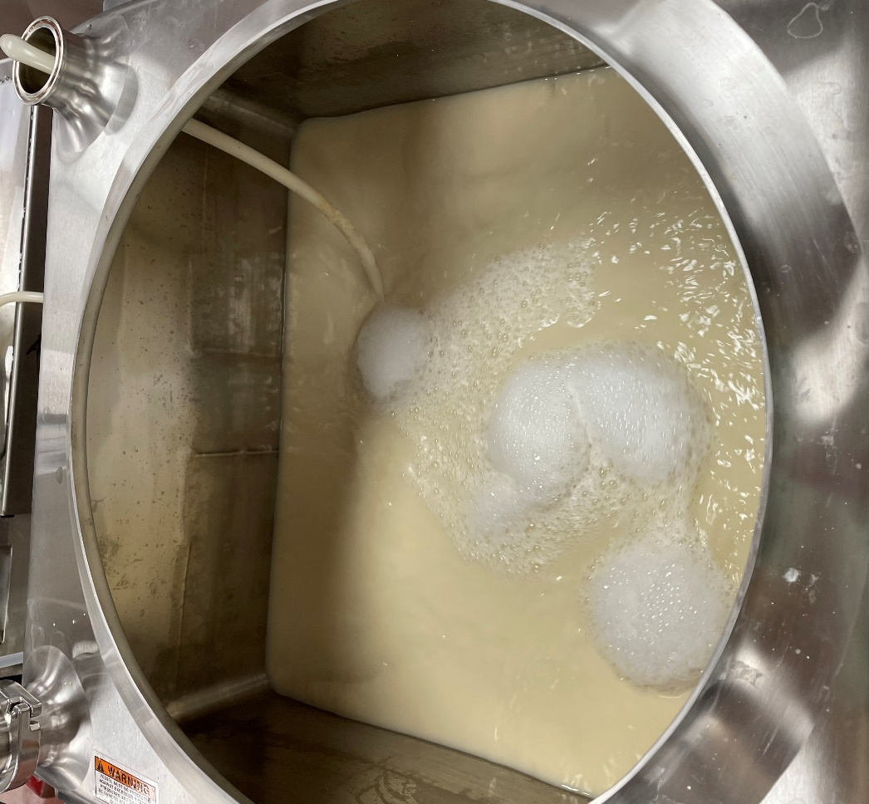
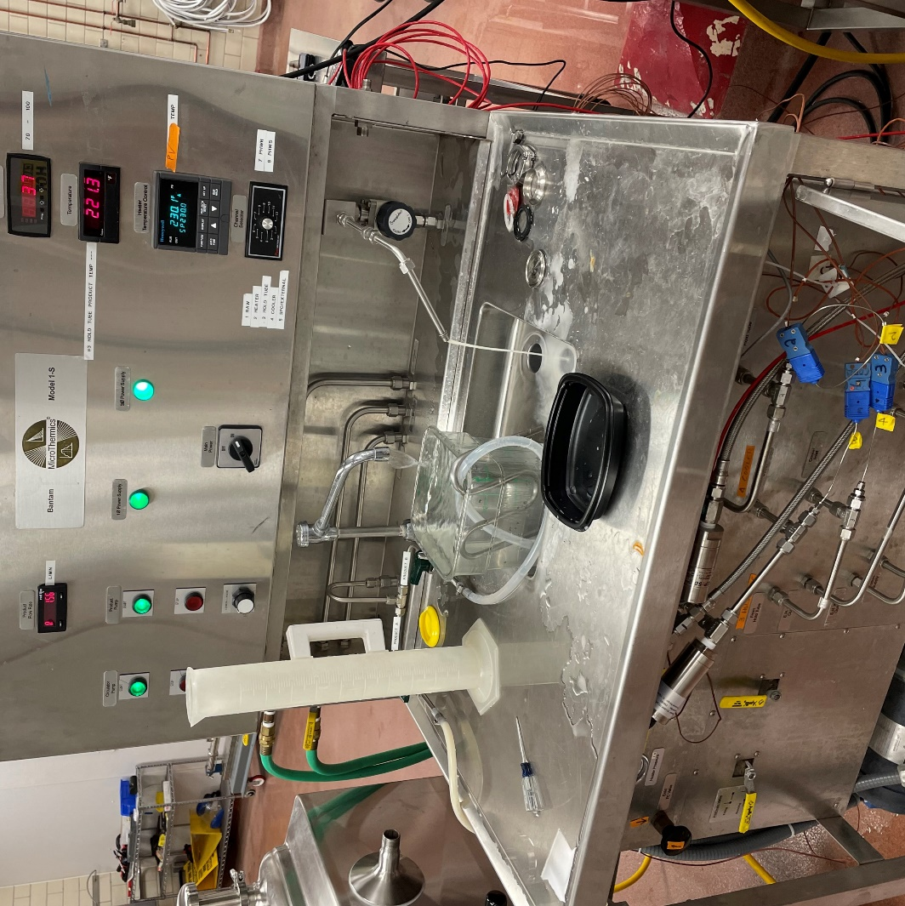
Ongoing and Future Work
Perform analysis on PBMAs for additional micronutrients, including trace minerals (e.g., zinc and selenium), choline, vitamin A, and B vitamins
Perform experiments in GMP pilot plant examining the effect of HTST processing (high-temperature short-time) on retention of micronutrients in an in-house formulated almond PBMA
Batching of almond PBMA
in Breddo Likwifier
MicroThermics unit for HTST treatment
18

Slide 19
Acknowledgements
CFSAN/Moffett: Lauren Jackson & Glenn Black
CFSAN/ONFL: Pat Hansen & Jeanmaire Hryshko
CFSAN/OAO: Marc Boyer
IIT: Joe Zuklic, Aman Sandhu, Jason Wan, Josh Warren, Ed Steiner
IIT Students: Violeta Sevillano Pires, Shalaka Shetge, Lillian Wang

Slide 20

Thanks for listening!
Contact: Benjamin.Redan@fda.hhs.gov

Slide 21
Supplemental Slides

Slide 22
NIST Reference Material
NIST SRM 1869 reference material (Infant/Adult Nutritional Formula) was used for quality control
Calcium recovery (n=3) was 104±1.7%
Mean recovery (n=3) was 92.7±1.4% for D2 and 102±4.3% for D3
Precision (%CV) over 5 non-consecutive days was 10.0% for D2 and 4.5% for D3
2

Slide 23
Recommended Dietary Allowances (RDAs) for Calcium
Age | Male (mg/d) | Female (mg/d)
0-6 mo* | 200 | 200
7-12 mo* | 260 | 260
1-3 y | 700 | 700
4-8 y | 1,000 | 1,000
9-13 y | 1,300 | 1,300
14-18 y | 1,300 | 1,300**
19-50 y | 1,000 | 1,000**
51-70 y | 1,000 | 1,200
>70 y | 1,200 | 1,200
*Adequate Intake (AI)
**RDA is the same during pregnancy or lactation
Institute of Medicine. Dietary Reference Intakes for Calcium and Vitamin D. Washington, DC: The National Academies Press; 2011.

Slide 24
Recommended Dietary Allowances (RDAs) for Vitamin D
Age | Male (µg/d) | Female (µg/d)
0-12 mo* | 10 | 10
1-13 y | 15 | 15
14-18 y | 15 | 15**
19-50 y | 15 | 15**
51-70 y | 15 | 15
>70 y | 20 | 20
*AI (adequate intake)
**RDA is the same during pregnancy or lactation
Institute of Medicine, Food and Nutrition Board. Dietary Reference Intakes for Calcium and Vitamin D. Washington, DC: National Academy Press, 2010.

