Slide 1
Premarket Review of Food Ingredients in the United States
Todor I Todorov
FDA, Center for Food Safety and Applied Nutrition
Office of Food Additive Safety
Division of Food Ingredients
todor.todorov@fda.hhs.gov
January 17, 2024

Slide 2
Presentation Overview
Federal Food, Drug, and Cosmetic Act
Definitions
Food ingredients
Food additives
Legal basis
GRAS ingredients
Food from animal cell culture
Consultation program

Slide 3
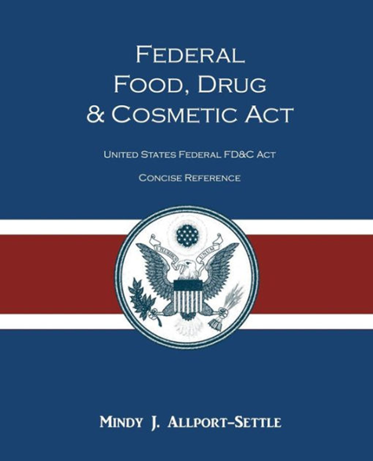
Federal Food, Drug, and Cosmetic Act
1938
Food, drug, and cosmetic act
1960
Color additive amendment
1997
GRAS notification proposal
2016
Final GRAS rule
1958
Food additive amendment
1997
Pre-market notification for food contact substances

Slide 4
FDA’s Approach to Food Innovation
Innovations in science and technology continue to generate new food production technologies, novel food ingredients, and novel sources of ingredients
FDA combines long-standing authorities with policy and scientific knowledge to ensure food safety
This approach is flexible and adaptable to a wide variety of new food production technologies and ingredients

Slide 5
Food additives
Any substance that may reasonably be expected to become a component, or otherwise affect the characteristic, of food.
Direct Food Additive
Indirect Food Additive
Directly added to food, technical effect in food, remain in food
Food additive petition (FAP), Generally Recognized as Safe (GRAS)
Added to food as the result of food-contact use (food contact substance)
Not intended to have a technical effect in or on the food
FCN
Secondary Direct Food Additive
Substances added to food, not intended to remain in food after technical effect has been accomplished
FAP, GRAS, Food Contact notification (FCN)

Slide 6
The Legal Basis
One Safety Standard: Reasonable Certainty of No Harm
Food Additives
GRAS ingredients
Subject to pre-market approval
Petition process
Safety information in public domain
Reflects expert consensus
Successful petition results in a regulation in 21 CFR
Not subject to premarket approval (notification process)
GRAS notices inventory

Slide 7
Pathways to Establish GRAS
Common use in food prior to 1958*
Substantial use in food by a significant number of consumers
Rare
Scientific procedures*
Scientific evidence of safe use
Safety is based on published studies in the scientific literature
*21 CFR § 170.3(c)

Slide 8
Food Additives and GRAS ingredients
FDA premarket review
Food additives
Evidence of safety
GRAS ingredients
General recognition
Evidence of safety
General acceptance of safety data
General availability of safety data

Slide 9
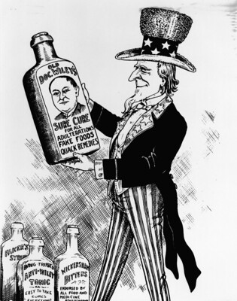
Safety Standard
Legislative History of the FD&C Act:
“The concept of safety used in this legislation involves the question of whether a substance is hazardous to the health of man or animal. Safety requires proof of a reasonable certainty that no harm will result from the proposed use of an additive.”
“It does not—and cannot—require proof beyond any possible doubt that no harm will result under any conceivable circumstance.”
H.R. Report No. 2284, 85th Congress 1958

Slide 10
GRAS notice evaluation
Safe for intended food use
Identity
Manufactu-ring process, Specifica-tions
Intended uses and technical effect
Dietary exposure
Safety narrative
Safety standard: reasonable certainty of no harm

Slide 11
FDA response letter
No questions
FDA does not question the basis for the notifier's GRAS conclusion
Insufficient basis
FDA concludes that the notice does not provide a sufficient basis for a GRAS conclusion
Cease to evaluate
Notifier requests that FDA cease evaluation of the notice

Slide 12
Notes about GRAS Ingredients
Specific to use
An ingredient on its own cannot be GRAS
Notifying FDA of a GRAS conclusion is not mandatory; complying with the law is required!
FDA response to a GRAS notice is NOT a regulation or approval
Color additives cannot be GRAS
Consult with FDA early in your development process (pre-submission meetings)
Questions? Premarkt@fda.hhs.gov

Slide 13
cultured Animal cells used for HUMAN food production

Slide 14
FDA’s Roles and Responsibilities
FDA’s voluntary pre-market consultation process (CCC) evaluates the safety of food made from cultured animal cells before it enters the market
Evaluates production process, manufacturing, components, and inputs
Ensures conformance with applicable FDA requirements
Questions? AnimalCellCultureFoods@fda.hhs.gov

Slide 15
FDA’s Premarket Consultation on Cultured Animal Cell Foods
In addition to the safety assessment components for food additives and GRAS ingredients, FDA premarket consultations also evaluate:
Production materials/processes and manufacturing controls
Cell collection, cell banking and cell proliferation
Conduct food production facility inspections and related activities
Oversee food products incorporating cultured fish and seafood cells
FDA engages with FSIS on consultations involving livestock (including Siluriformes fish) and poultry cell lines, and share the results of consultations. FDA helps to coordinate the transfer of regulatory oversight to FSIS

Slide 16
Conclusion
Innovations in science and technology continue to generate new ways of producing food
E.g., precision fermentation, animal cell culture
FDA combines long-standing authorities with policy and scientific knowledge to regulate food safety
Established framework (e.g., FAPs, GRAS) may be applied to “innovative” ingredients added to conventional food
E.g., ingredients derived from microbial fermentation, novel protein sources
New frameworks developed (e.g., CCC), as science and technology evolve, but rely on established standard of safety

Slide 17
?
Premarkt@fda.hhs.gov
AnimalCellCultureFoods@fda.hhs.gov

