Slide 1
Leveraging Artificial Intelligence for Food Safety Regulation
Ernest K. Kwegyir-Afful, Ph.D, RAC

Slide 2
Warp Intelligent Learning Engine (WILEE)
WILEE is designed as data product with a flexible architecture that allows application to a variety of use cases.
Knowledge base and calculators
Signal detection
Post market monitoring
Knowledge discovery
Stakeholder sentiment/activity tracking

Slide 3
GenAI Implementation in WILEE
Implementation with GENAI (Llama 3.2, Anthropic Claude )
NER (chemicals, products, pathogens, adverse events)
-Huggingface
-Ollama
-AWS Bedrock
Clean/standardize
Chemicals, products, pathogens, adverse events
Score AE
Public health impact scores
Classify chemicals
Contextual analysis
Food additives
Contaminants
Drugs
Web data and Scientific publications
Signal texts (abstracts & text)
Integrate and extract
Relevance classification
& Signal prediction
Subject signal substance
Knowledge discovery
CFR (170-199; 101)
Integrate & interrogate
Signals data
Label ingredients
Standardize Ingredient names
Clean/standardize

Slide 4
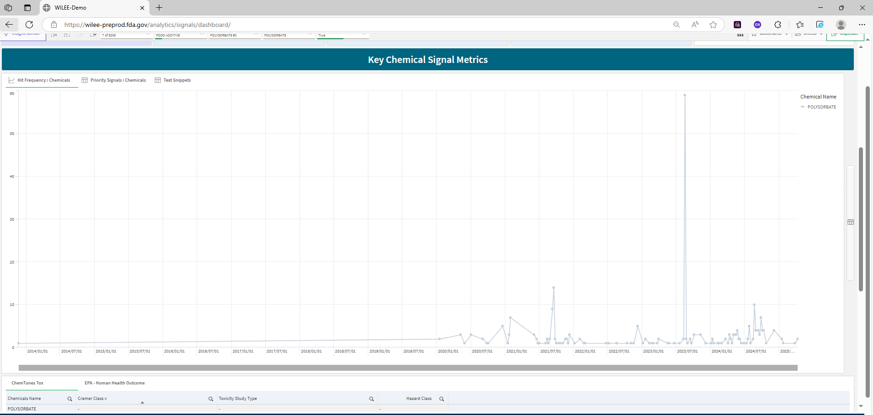
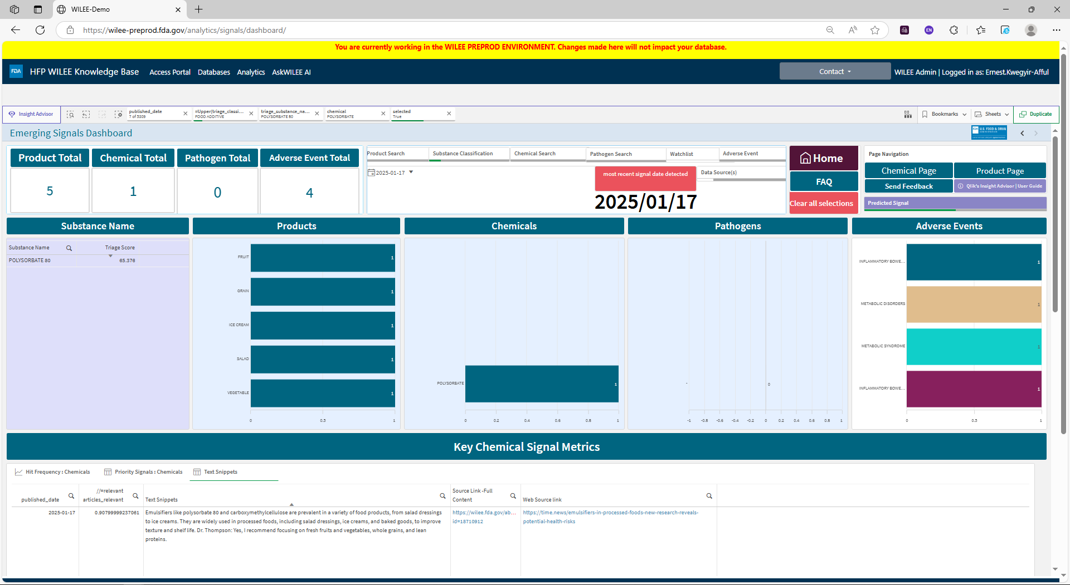
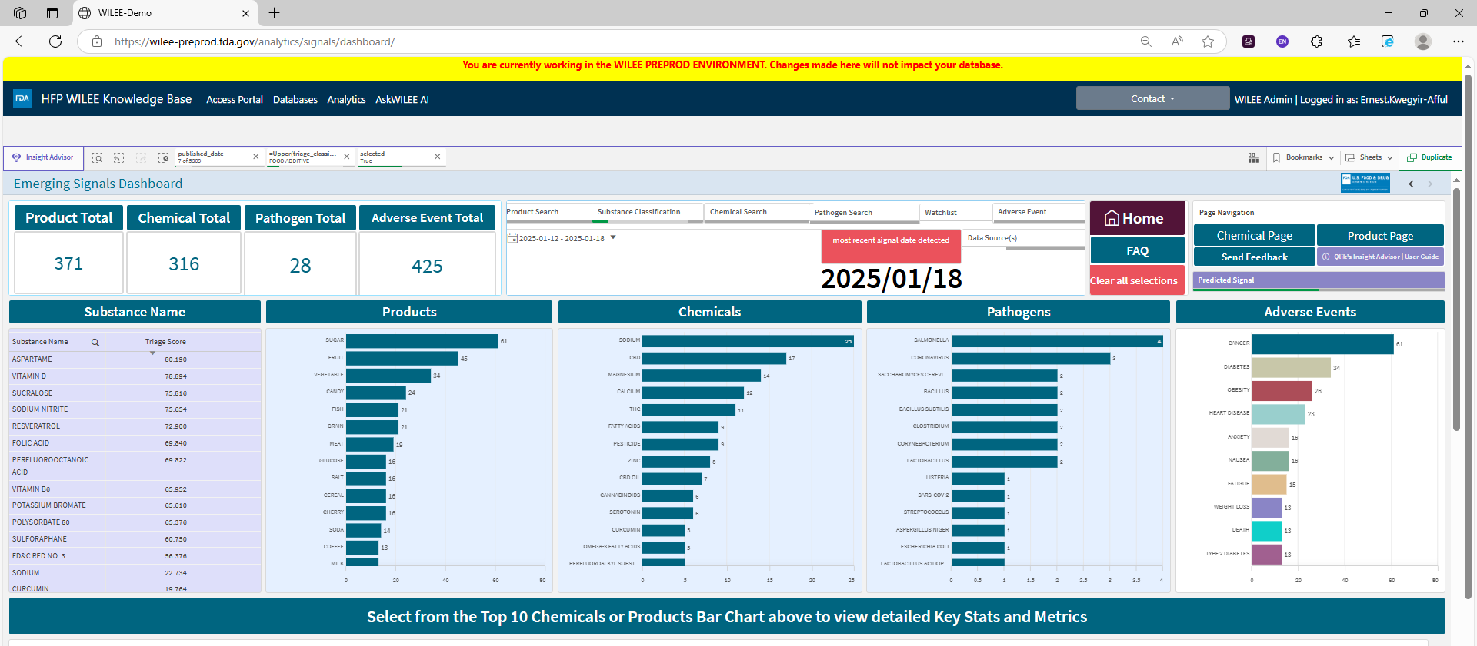
WILEE Signal Detection

Slide 5
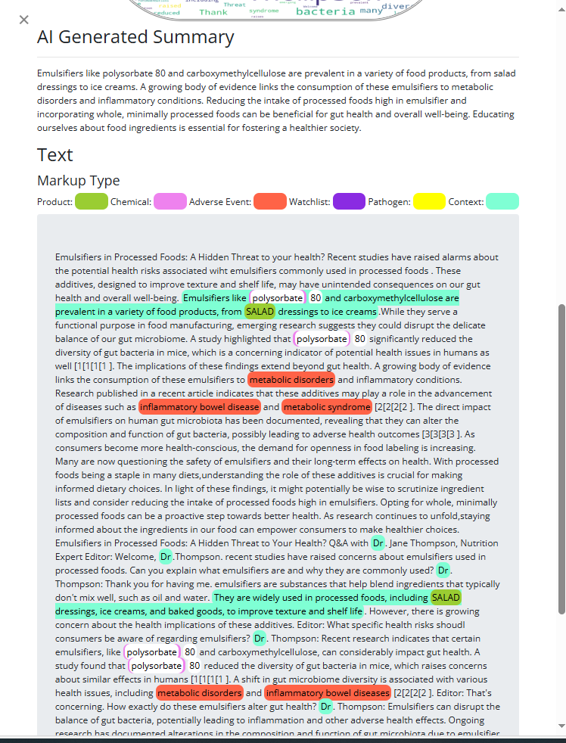
WILEE Knowledge Discovery

Slide 6
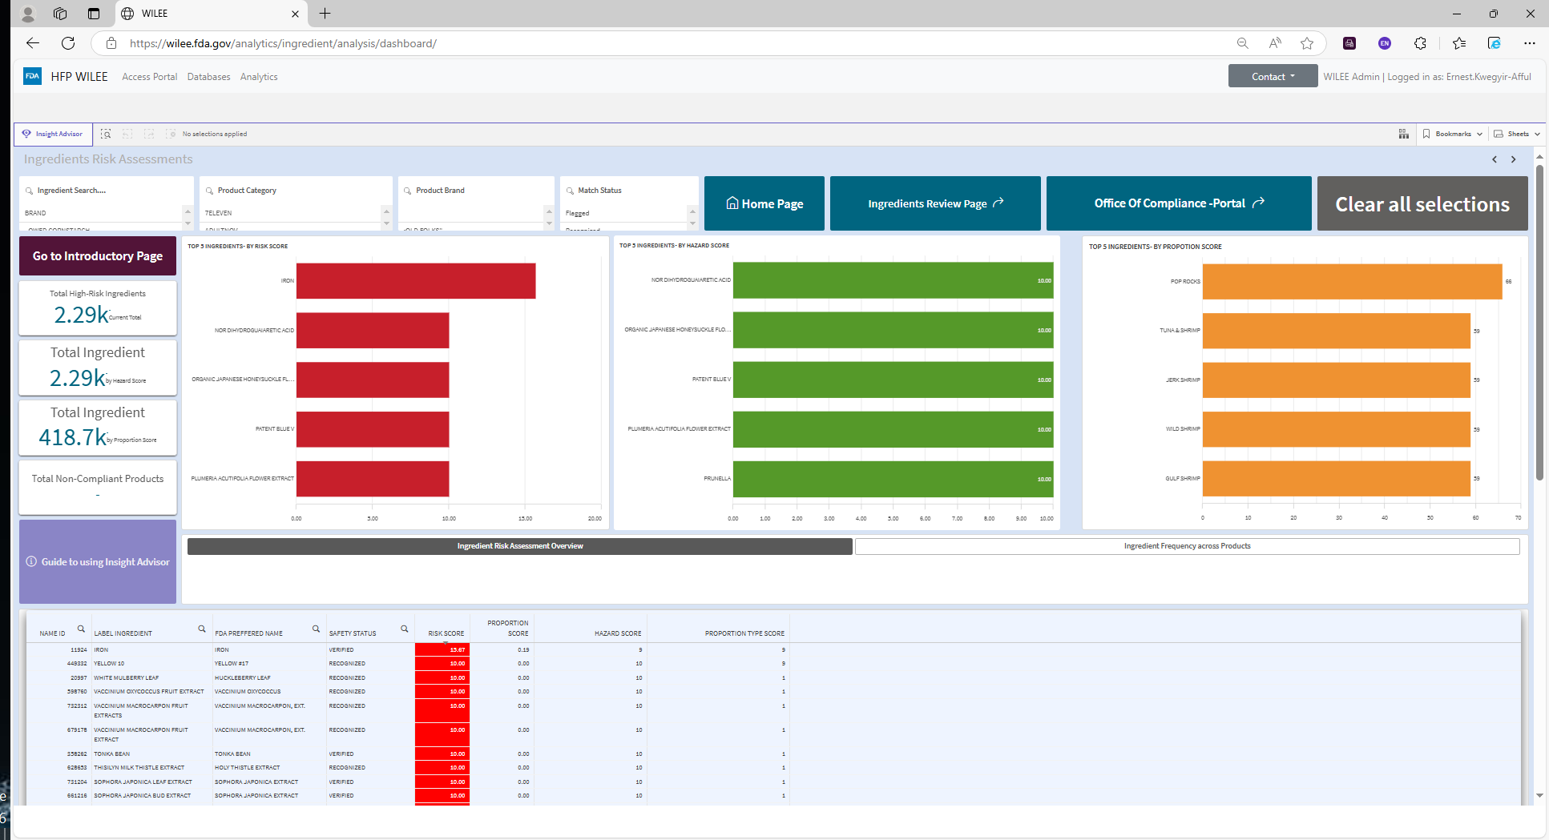
WILEE – Post market food ingredient monitoring

Slide 7
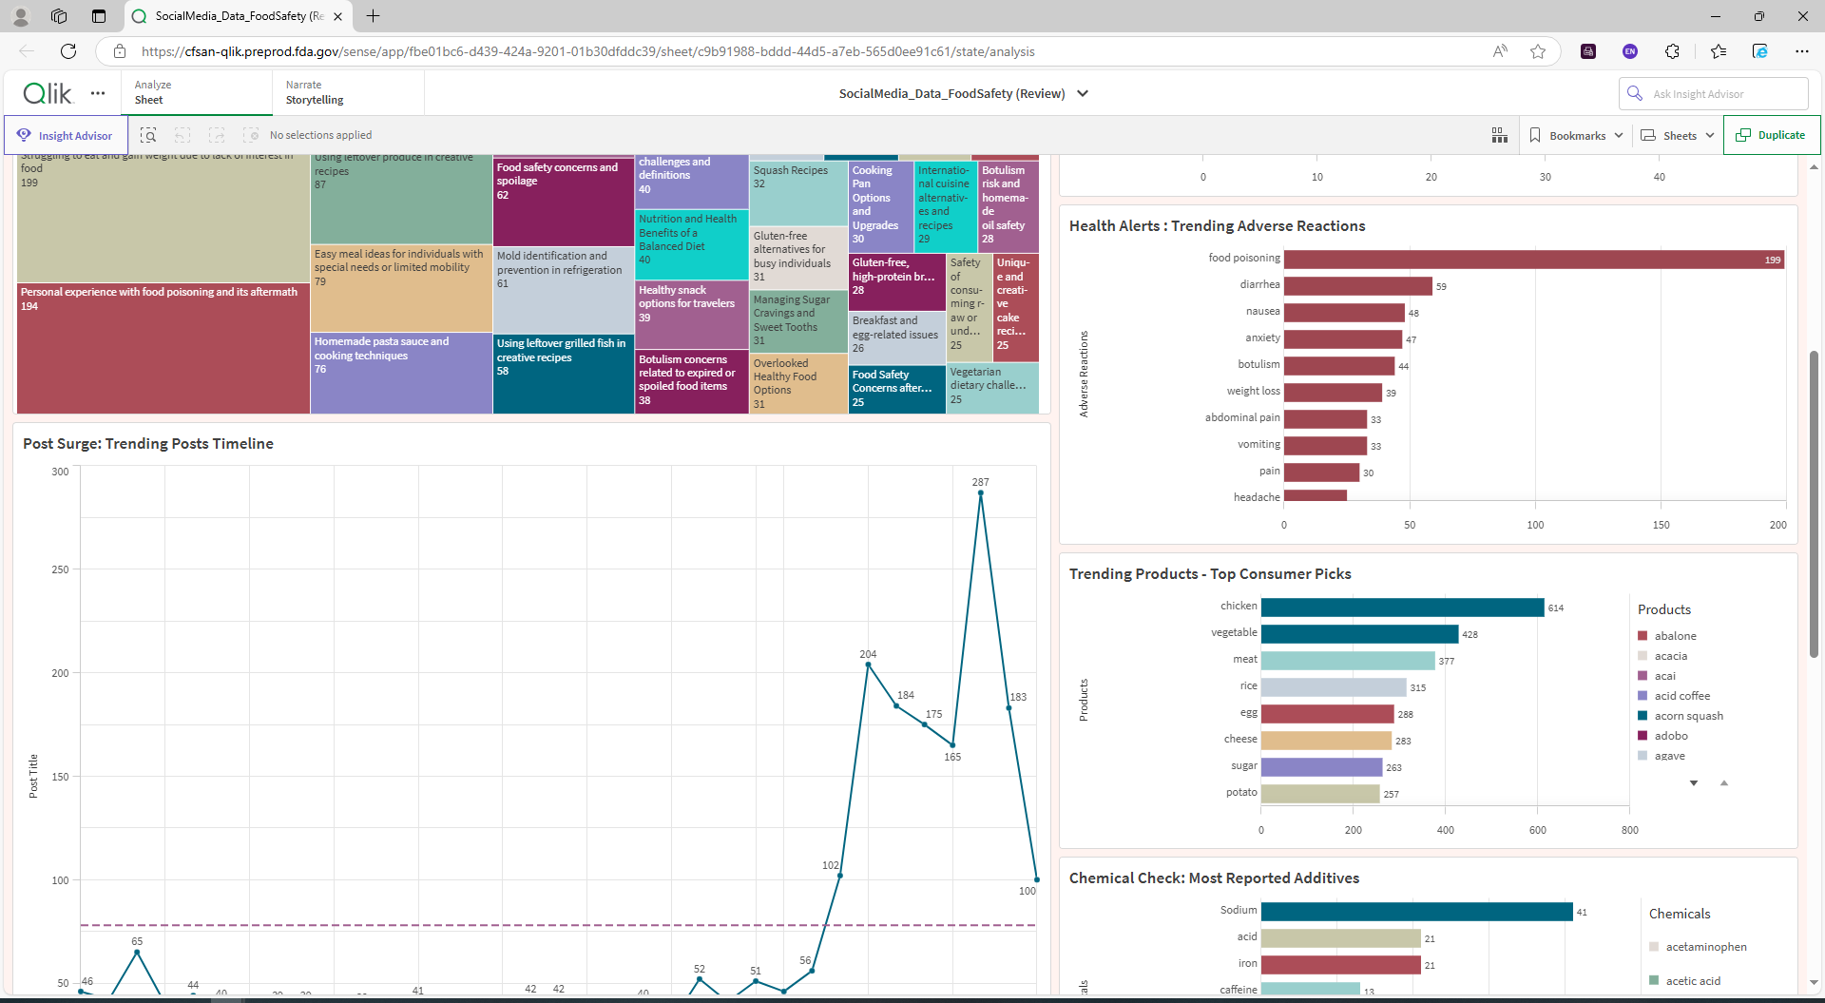
WILEE – Stakeholder concern evaluation

Slide 8
New components of WILEE
Advance knowledge discovery – “Ask WILEE”
Predicting sample violation for laboratory testing of chemicals and microbial substances.
Knowledge graph
Economically motivated adulteration
Horizon scanning using grant data from NIH and USDA

Slide 9
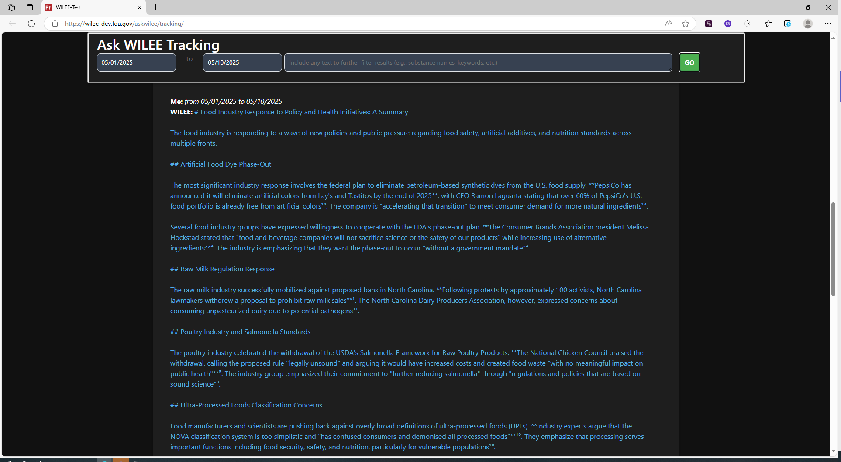
Ask WILEE – Tracking Industry Actions

Slide 10
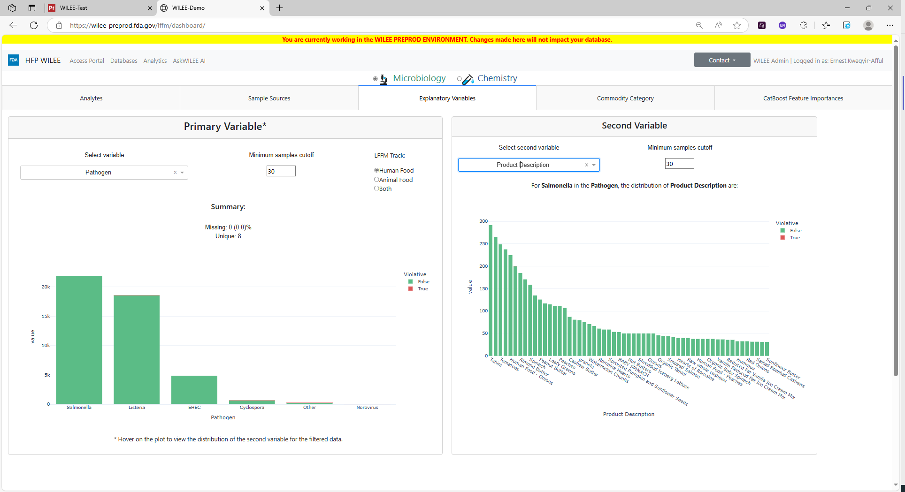
Predicting violation for laboratory samples

Slide 11
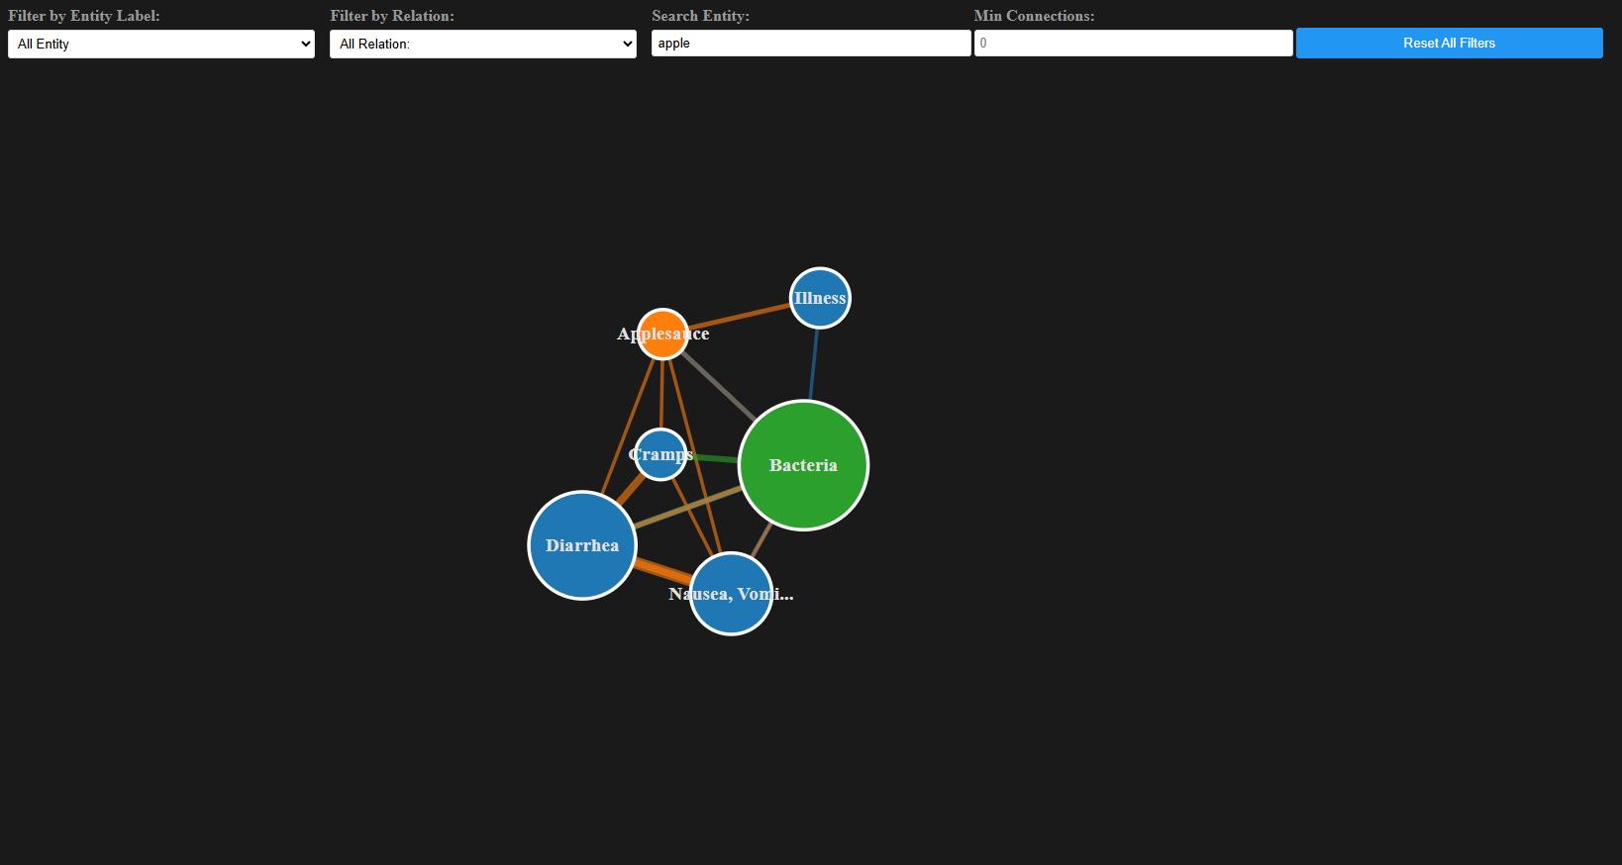
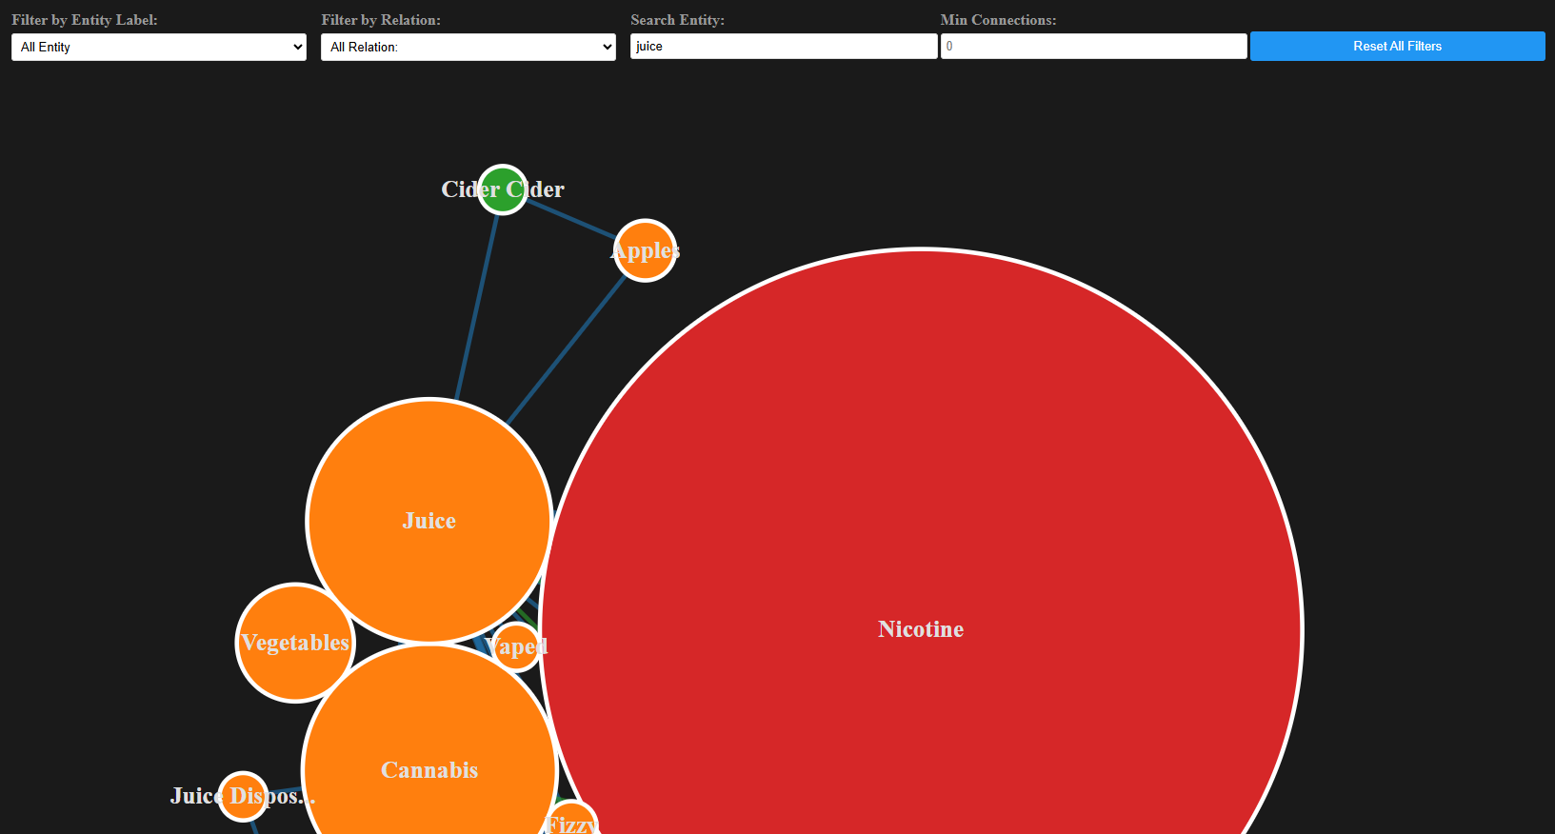
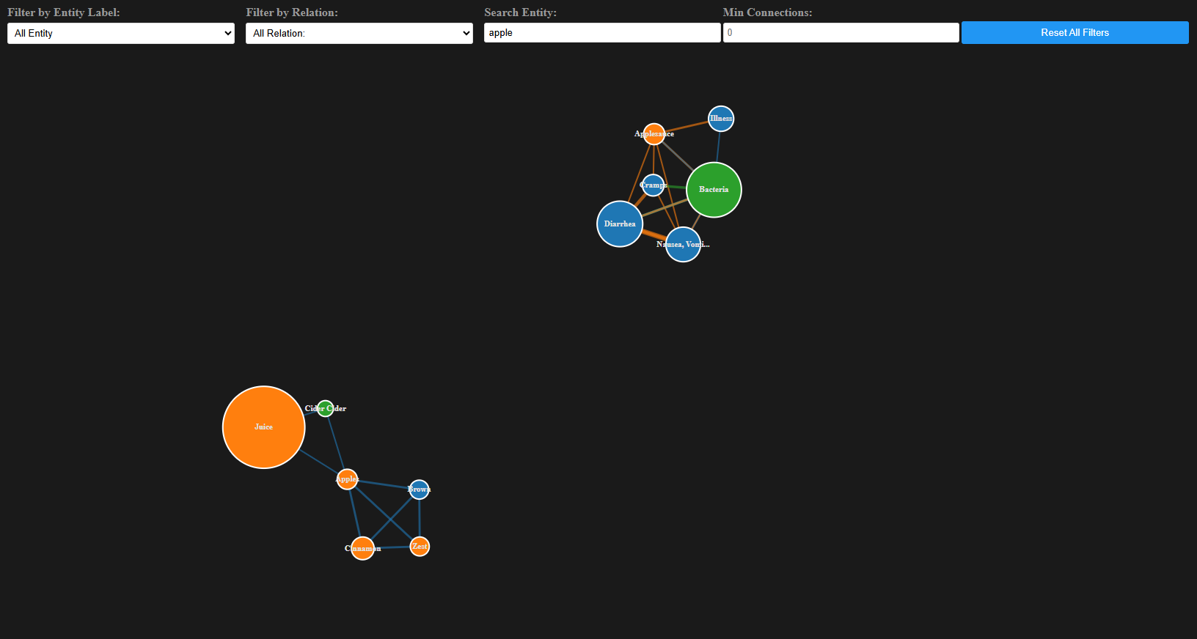
Knowledge Graph

Slide 12
U.S. Food and Drug Administration, Human Foods Program logo

